Slide 1
Probability & Statistics
Correlation and Regression
Ben Baumer

Slide 2
Content
Visualizing Two Variables
Correlation
Simple Linear Regression
Interpreting Regression Models
Model Fit

Slide 3
Visualizing Two Variables
We will learn techniques for characterizing and quantifying the relationship between two numeric variables (i.e. bivariate relationships)
Output response; dependent variable; y
Input something you think might be related to the response; independent variable; explanatory variable; predictor, x
A scatterplot is the most useful way to visualize the response (y-axis) versus the predictor (x-axis).
Its helpful to think of a scatterplot as a generalization of a side-by-side boxplot of the discretized explanatory variable.
Applied R (Scatterplots and Boxplot)
ggplot(data = possum, aes(y = total, x = tail)) +
geom_point() +
scale_x_continuous(“Length of Possum Tail (cm)”) +
scale_y_continuous(“Length of Possum Body (cm)”)
ggplot(data = bdims, aes(y = wgt, x = hgt, color = factor(sex))) +
geom_point(alpha = 0.5, position = “jitter”)
ggplot(data = possum, aes(y = total, x = cut(tail, breaks = 5))) +
geom_boxplot()
ggplot(data = mammals aes(y = BrainWt, x = BodyWt)) +
geom_point() +
coord_trans(x = “log10”, y = “log10”)
ggplot(data = mammals aes(y = BrainWt, x = BodyWt)) +
geom_point() +
scale_x_log10() +
scale_y_log10()
ways to deal with overplotting
There are four characteristics of bivariate relationships that we want to observe:
Form linear, quadratic, non-linear, etc...
Direction positive (same direction), negative (opposite direction)
Strength how much scatter or noise
Outliers it is important to understand how the relationship changes when outliers are excluded
transforming the axis scaling can change your outlook on the form of the relationship

Slide 4
Assessing Performance
Accuracy
Computation time
Interpretability
Accuracy and Error are basic performance measures for Classification MLP

Slide 5
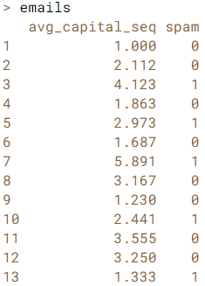
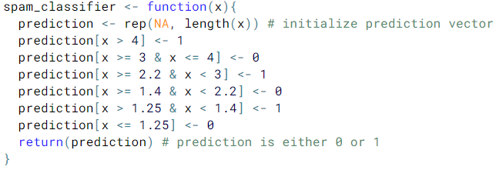

Classification
Classification MLP attempt to predict the category of a new observation.
Earlier Observations are used to estimate a Classifier
The classifier is then used to label a new observation with a Class
Classes are qualitative and predefined
Applied R (Classification: Filter Spam)
In this example the training data (emails) is used to develop the Classifier. However this is not a valid approach in an actual classification MLP.
Classifier
feature vector
label on observed data
Class predictions from our Classifier

Slide 6
Regression
Regression MLP attempt to estimate a Response value after a set of Predictors are pushed through a Regression Function.
In linear regression, the regression function is estimated by two paramaters β₀ and β₁
Applied R (Studying Information)

Slide 7
Clustering
Clustering MLP attempt to group similar objects in clusters while ensuring that each cluster is dissimilar from every other cluster.
Clustering is similar to classification MLP however the important distinction is that in clustering, the classes, or clusters, are not predefined.
Applied R (Studying Information)

